Slide 1
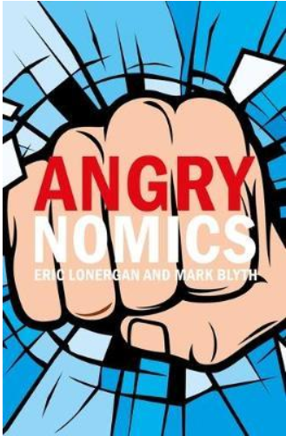
DatA RELATED to THE DISCONTENT?
The book “Angrynomics” looked at political discontent due to economic inequality. The proposed research involves the data analysis of taxes, inequality, and health (life expectancy). The solutions will be politically difficult to achieve.
Notes:
*The bottom line is that before-tax income inequality has risen since the 1970s, despite an increase in government transfer payments. Because high-income people pay higher average tax rates than others, federal taxes reduce inequality. But the mitigating effect of taxes is about the same today as before 1980. Thus, after-tax income inequality has increased about as much as before-tax inequality. Taxes have not exacerbated increasing income inequality, but have not done much to offset it.- Brookings Institute

Slide 2
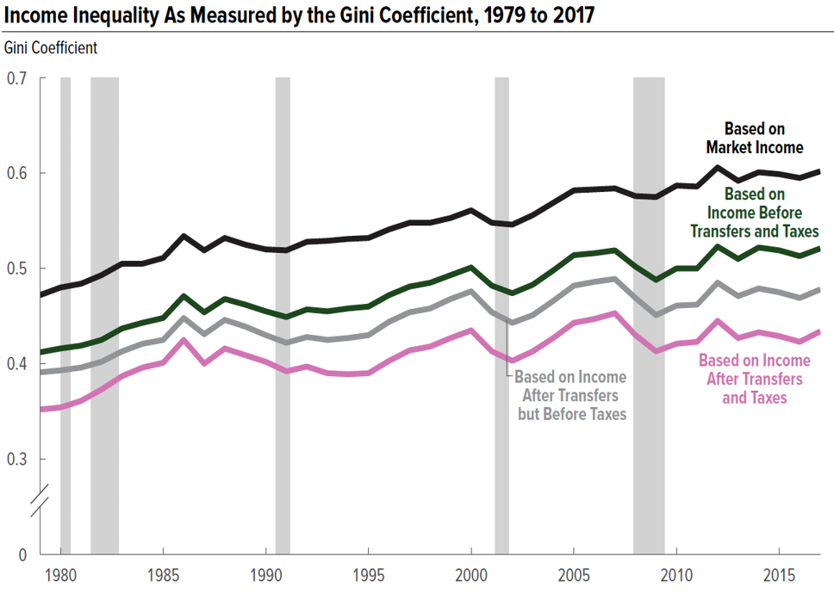
Notes:
**The data does not factor In Trump tax plan and economic impacts of COVID-19 pandemic

Slide 3
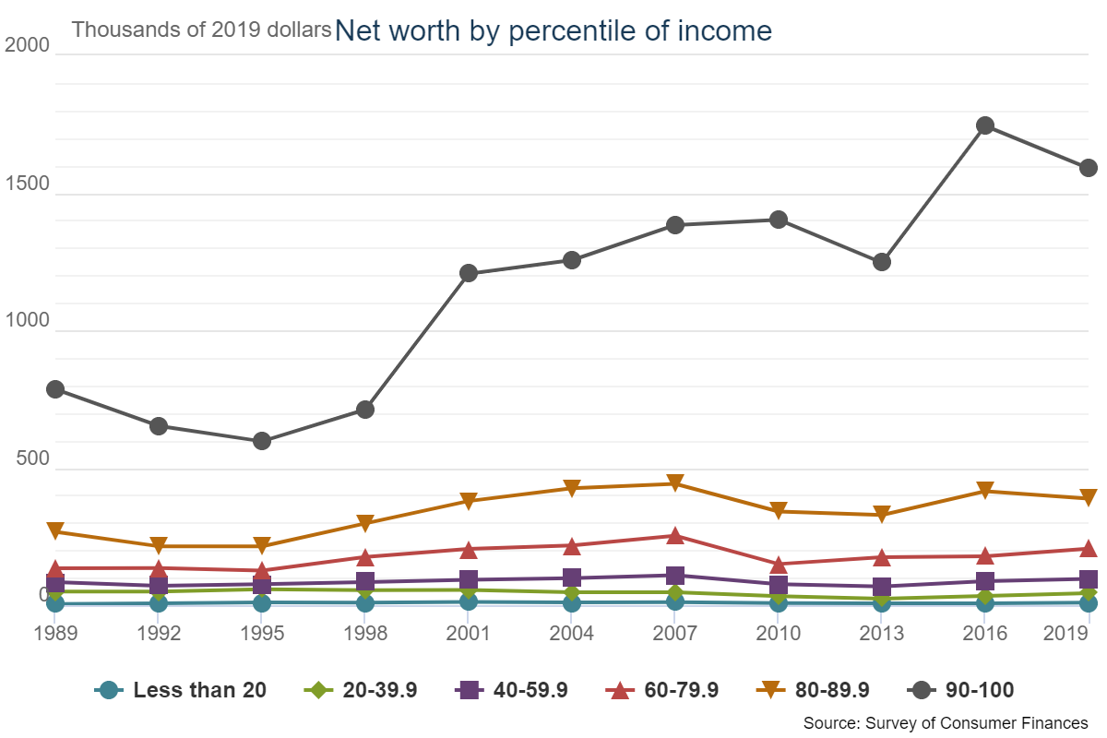
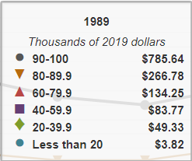
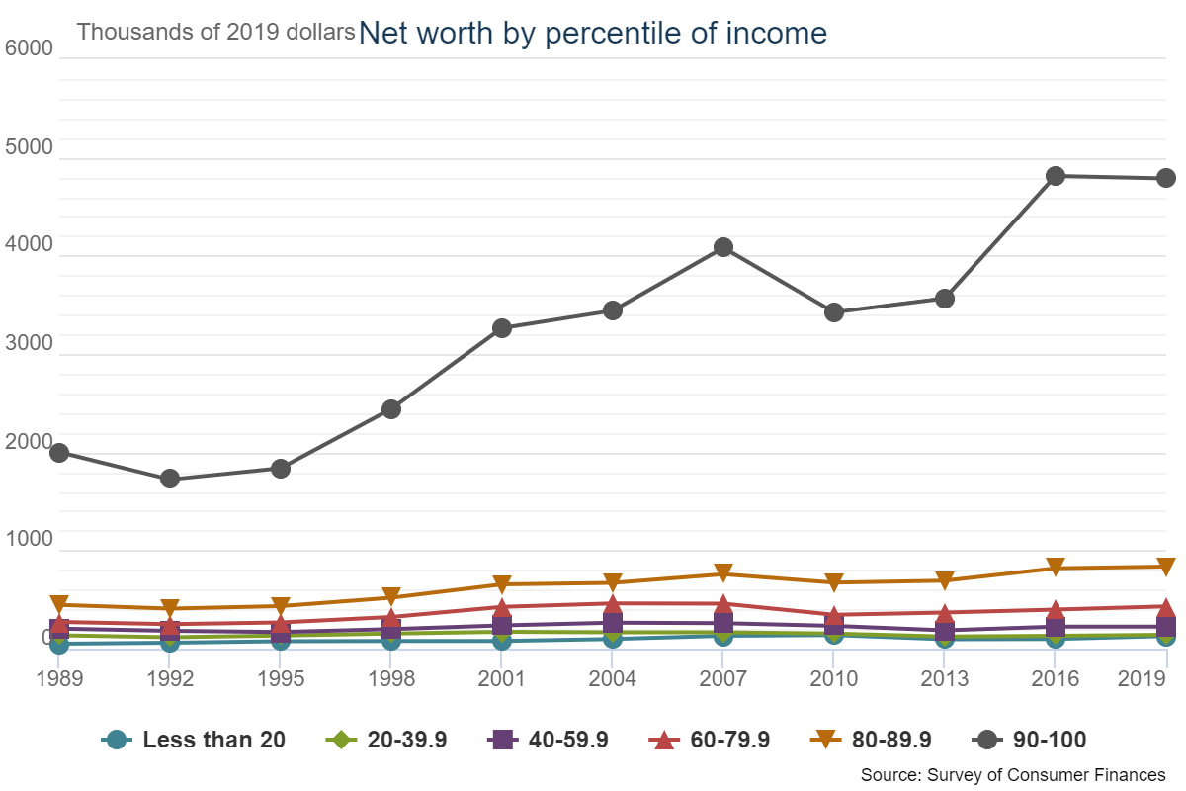
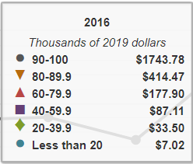
Notes:
From the Federal Reserve Economic Data- Median Net Worth

Slide 4
Association Between Income and Life Expectancy for 40 Year Old Americans in 2001-2014
90
85
Expected Age at Death for 40 Year Olds in Years
80
75
Women, Bottom 1%: 78.8
Women, Top 1%: 88.9
Men, Bottom 1%: 72.7
70
Men, Top 1%: 87.3
0
20
40
60
80
100
Household Income Percentile
Notes:
**Before COVID-19 pandemic but also during Opioid crisis
**Based on JAMA data

Slide 5
Projected Inequality and Life Expectancy Data/Chart

Slide 6
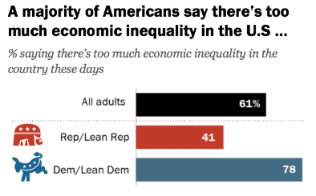
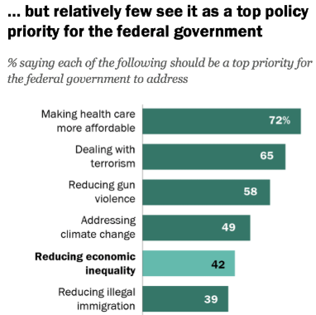
The Disconnect
Notes:
https://www.pewresearch.org/social-trends/2020/01/09/most-americans-say-there-is-too-much-economic-inequality-in-the-u-s-but-fewer-than-half-call-it-a-top-priority/ Pew Research Jan 2020

Slide 7
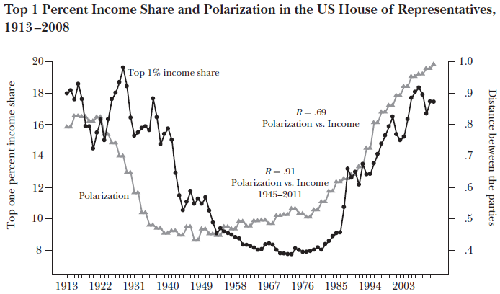
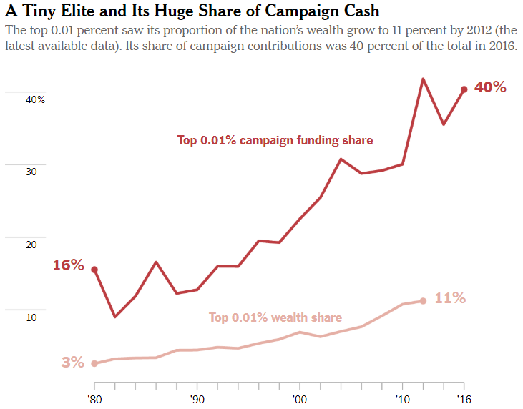
Political Solutions Seem Less Likely
Notes:
https://www.nytimes.com/2018/02/15/opinion/democracy-inequality-thomas-piketty.html-
https://www.researchgate.net/publication/262101269 Why Hasn't Democracy Slowed Rising Inequality?
Article in Journal of Economic Perspectives · August 2013

Slide 8
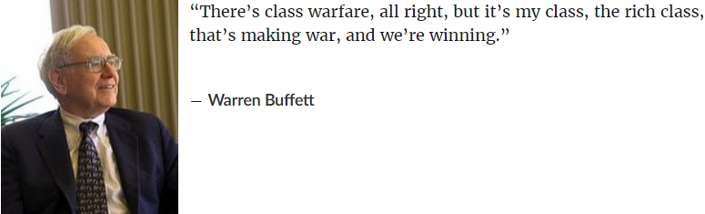
ENDING
Notes:
*The bottom line is that before-tax income inequality has risen since the 1970s, despite an increase in government transfer payments. Because high-income people pay higher average tax rates than others, federal taxes reduce inequality. But the mitigating effect of taxes is about the same today as before 1980. Thus, after-tax income inequality has increased about as much as before-tax inequality. Taxes have not exacerbated increasing income inequality, but have not done much to offset it.- Brookings Institute

